Slide 1
Life history strategies and succession

Slide 2
Phylogenetic vs. Functional classifications
Sharing the common history does not necessarily mean sharing similar functional traits (but there are phylogenetic constrains)
Convergent evolution under similar selection pressure (functionally analogous, but evolutionary unrelated species)
Functional description of vegetation over varying biogeographical areas

Slide 3
Just remember
Phylogenetic dissimilarity and trait dissimilarity are usually not independent
Thus, the phylogenetic classification and functional classification are rather complementary

Slide 4
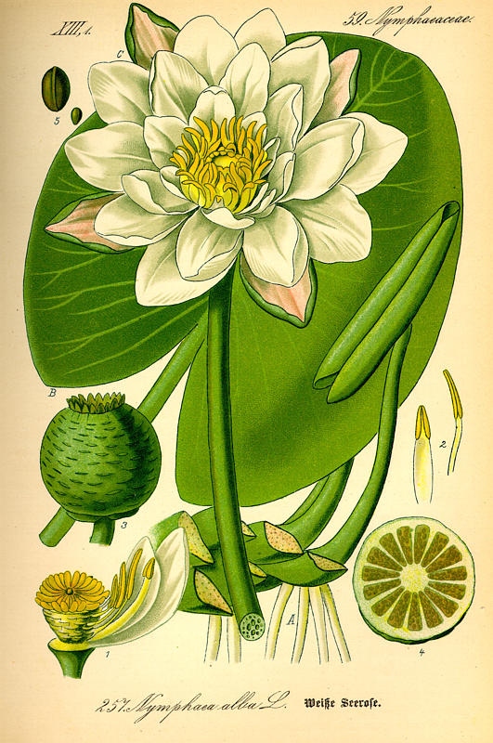
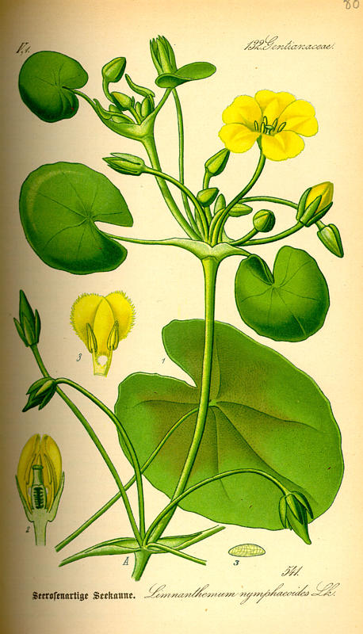
Nymphaea (Nymphaeaceae, basal angiosperms)
Nymphoides (Menyanthaceae, asterids)
Phylogenetically distant (common ancestor ca 280 milions of years) – high functional similarity

Slide 5
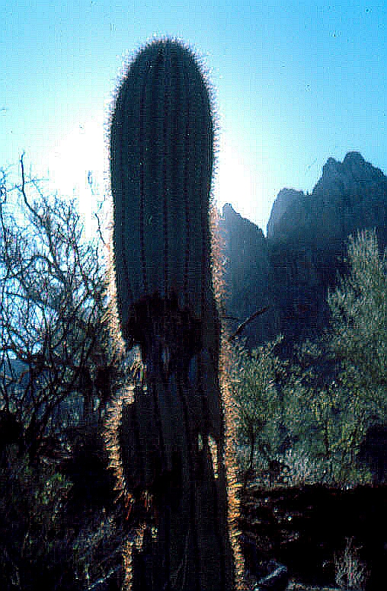
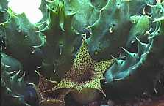
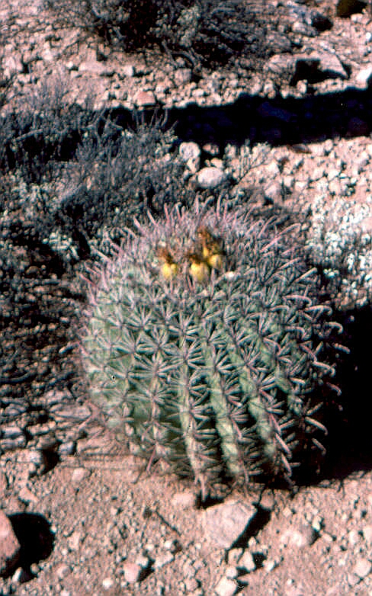
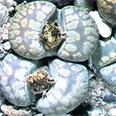
Cacti
non-cacti succulents

Slide 6
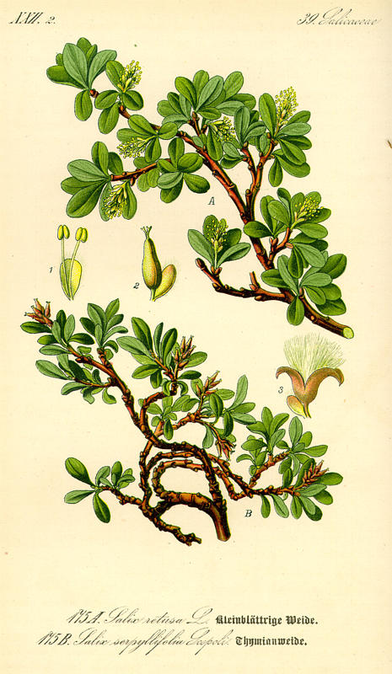
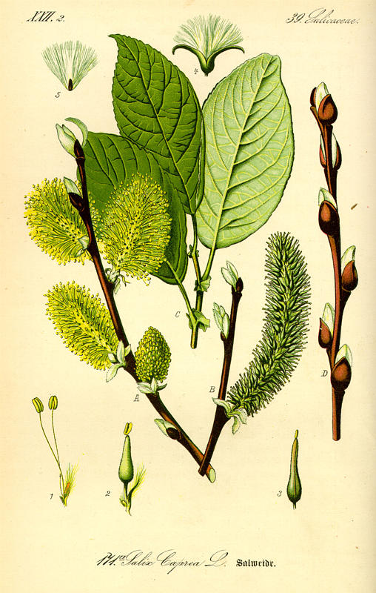
Salix retusa
Salix capraea
Phylogenetically closely related (common ancestor 500 000yrs) functionally very different

Slide 7
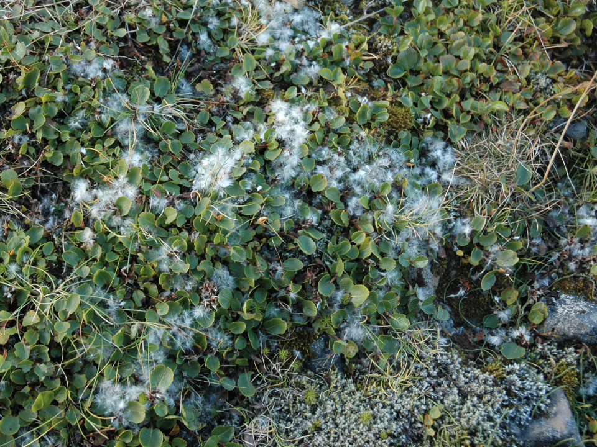
Salix herbacea

Slide 8
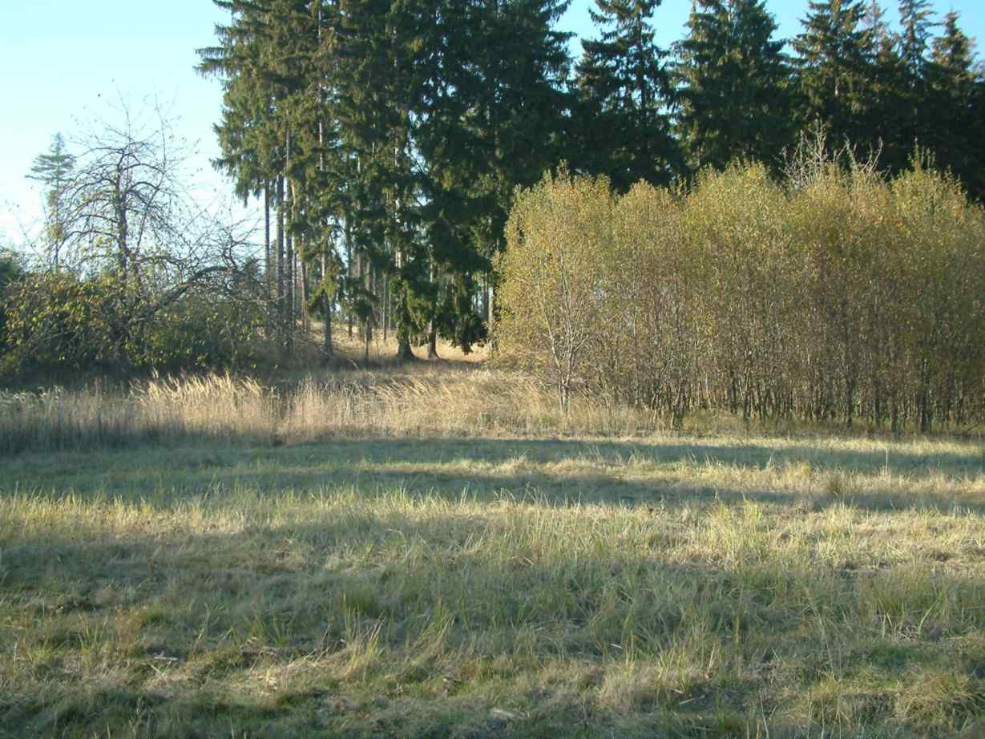
Salix caprea

Slide 9
Raunkier life forms (Based on the position of meristems during an adverse period) – „historical“, but still commonlyused
* Phanerophytes
* Chamaephytes
* Hemicryptophytes
* Geophytes
* Therophytes
(plus Epiphytes, Hydrophytes etc.)
Similar life-form composition in similar climates, irrespective of evolutionary history

Slide 10
Remember
Biomes are determined by the composition of life forms (and this is determined by climate)
Biogeographical regions are determined by taxonomical composition, i.e. by phylogeny and history

Slide 11
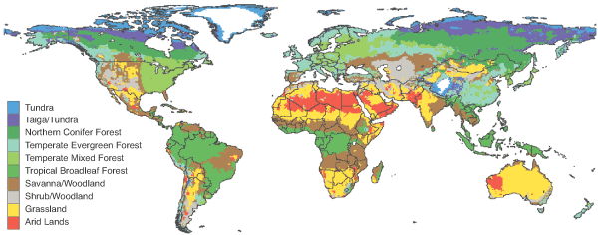
Biomes of the world

Slide 12
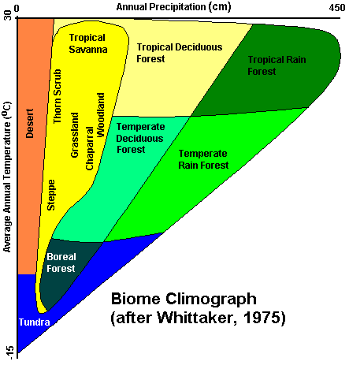
Determined by precipitation and temperature

Slide 13
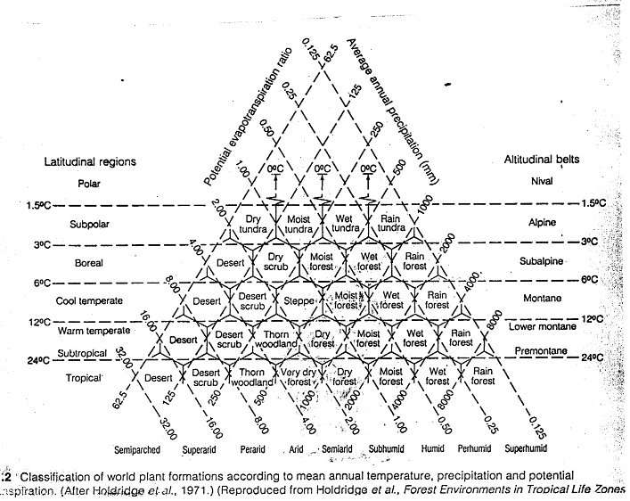
Holridge triangle

Slide 14
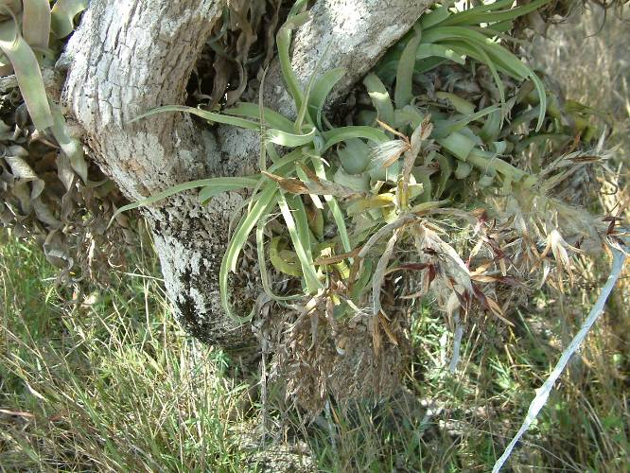
Dispersal limitation resulting in biogeographical patterns: Bromeliaceae are (nearly exclusively) found in the New World, even thought the living conditions would be OK even elsewhere.

Slide 15
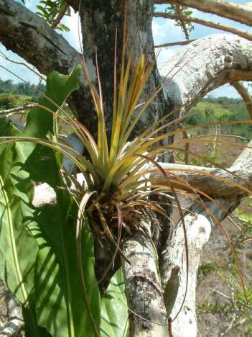
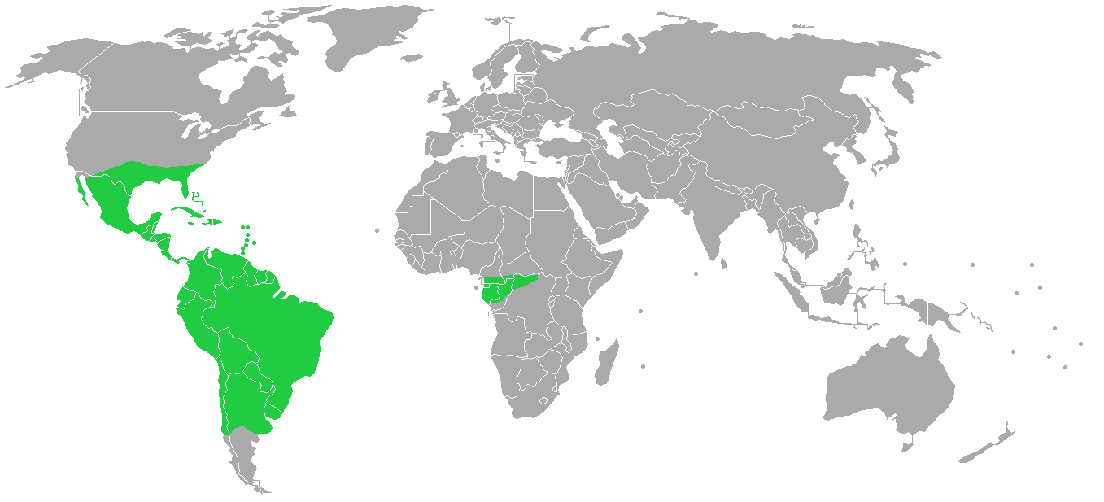
Distribution of Bromeliaceae
- (only single species in West Africa)

Slide 16
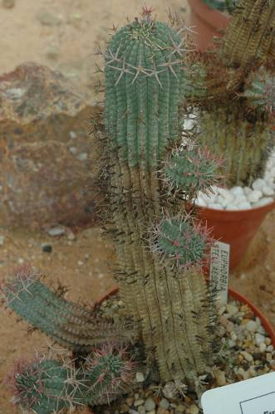
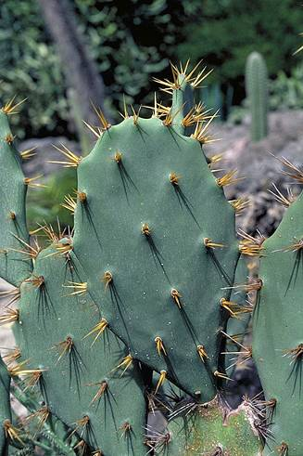
Konvergence: fylogeneticky nepříbuzné typy vypadají velmi podobně, protože žijí v podobném prostředí, byť často na velmi vzdálených kontinentech.
Euphorbiaceae ze Starého světa
Cactaceae - Nový svět

Slide 17
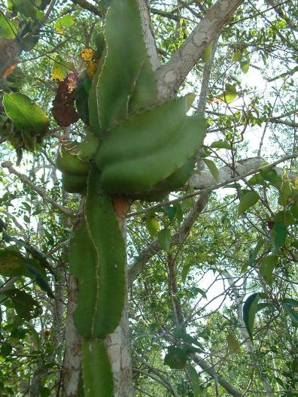
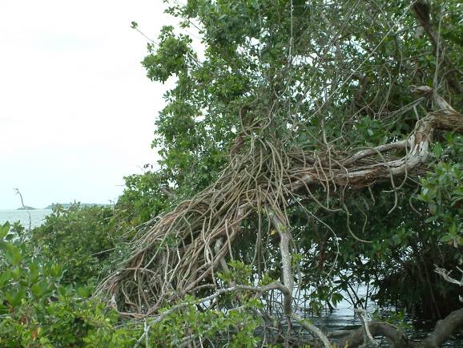
Cactace restricted to the New World, but there, not only deserts, but, e.g. they are epiphytes in tropical forests

Slide 18
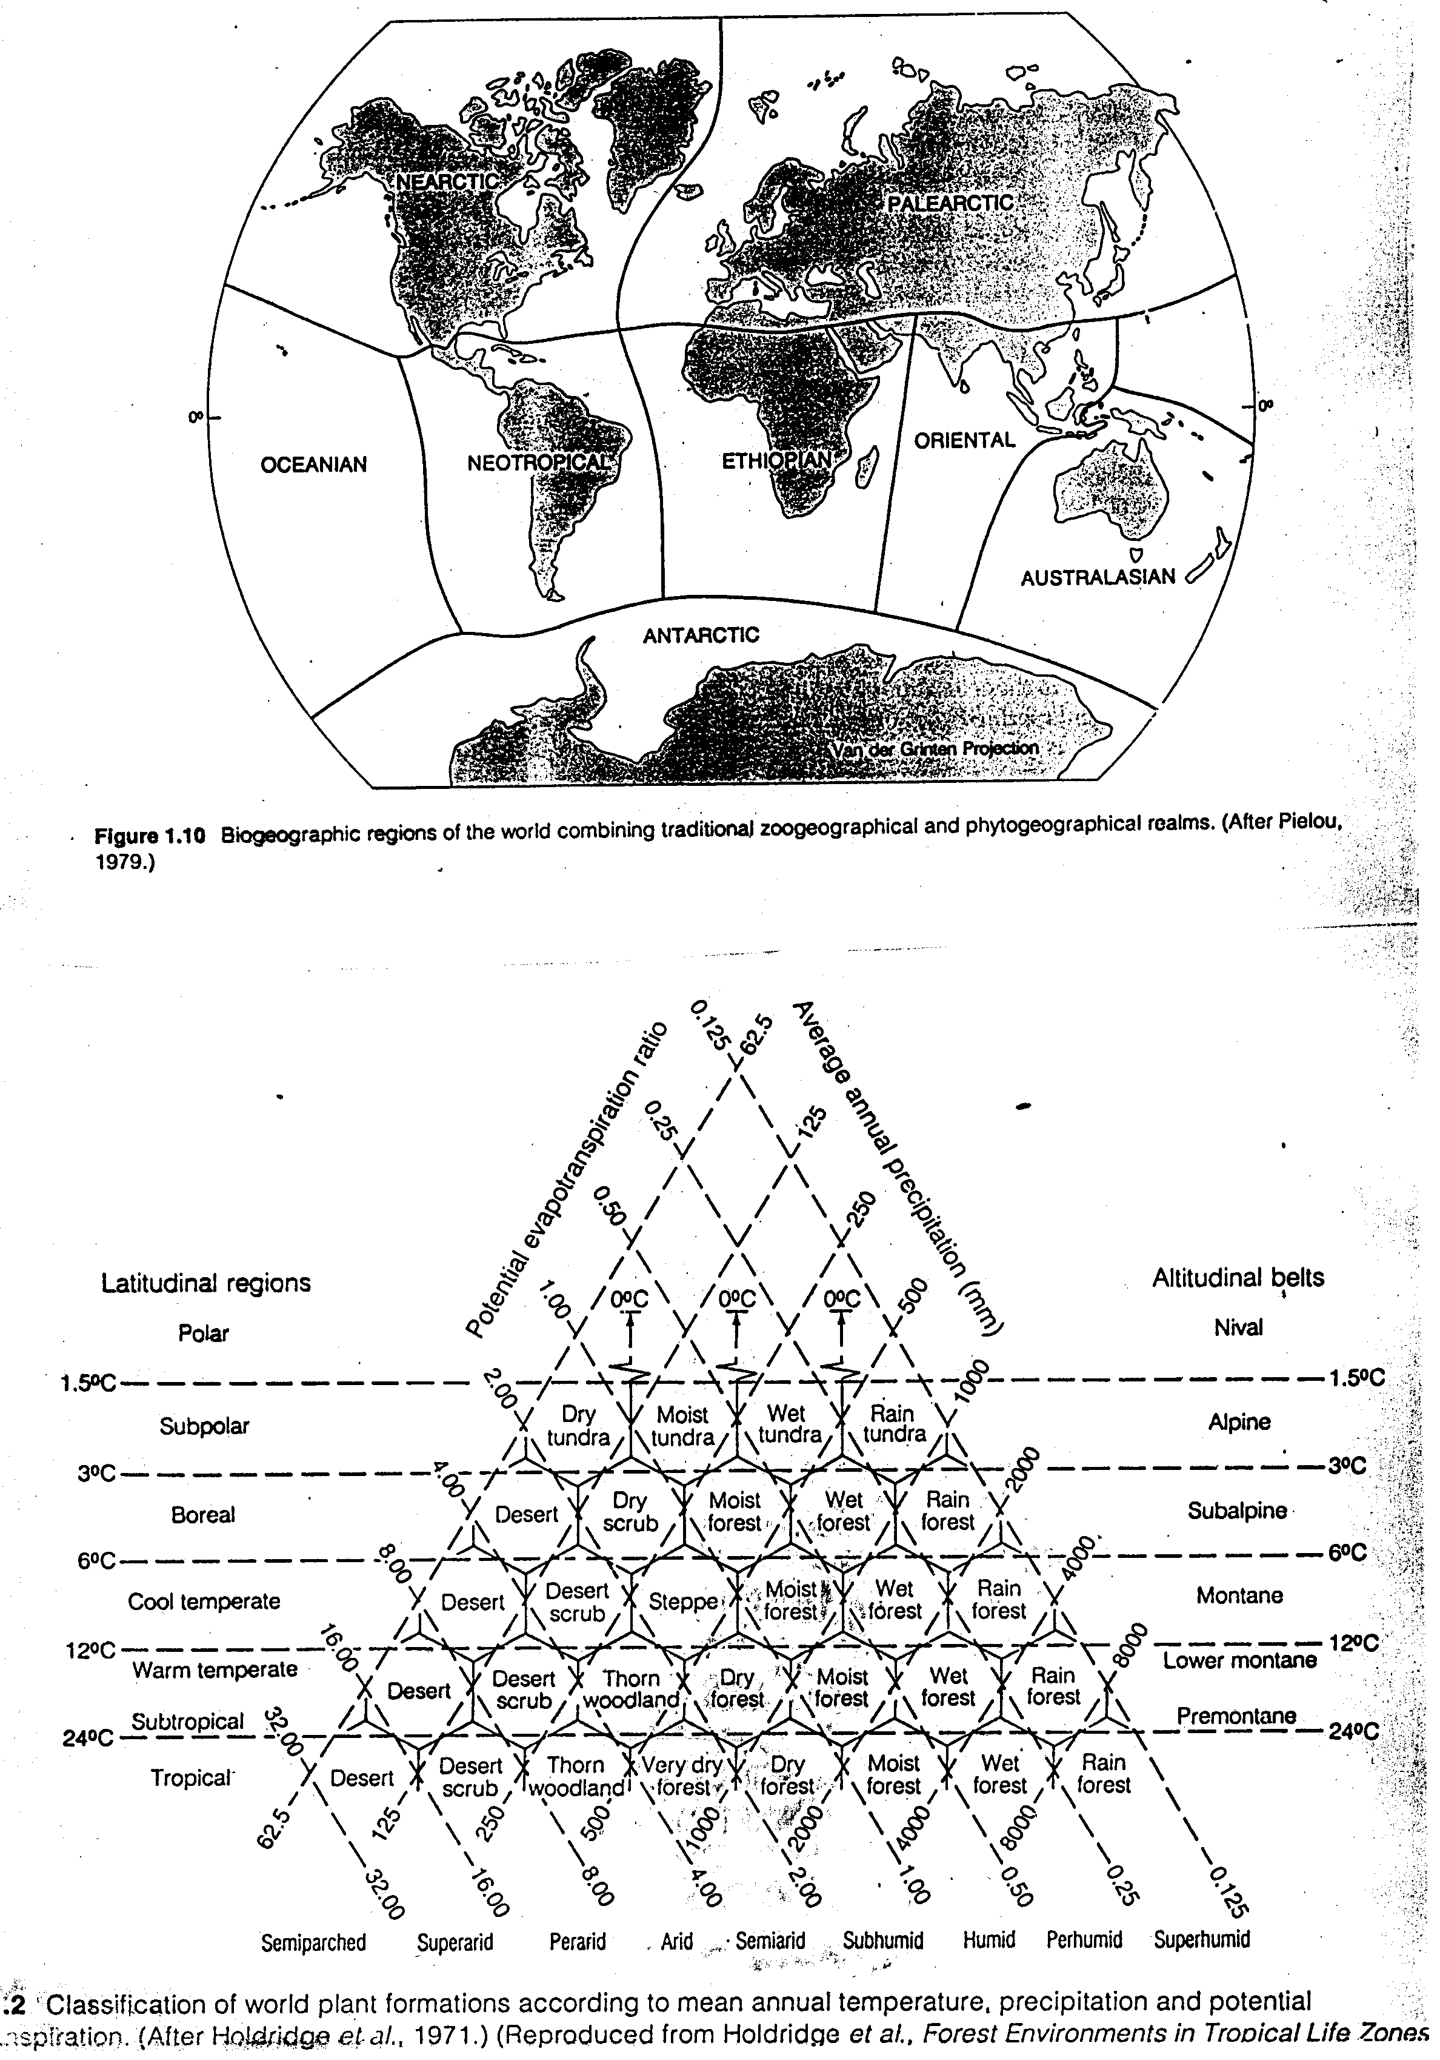
Biogeography of the world

Slide 19
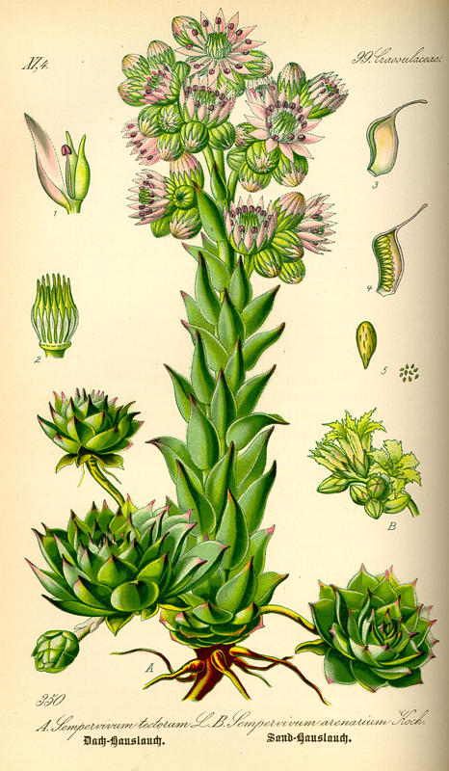
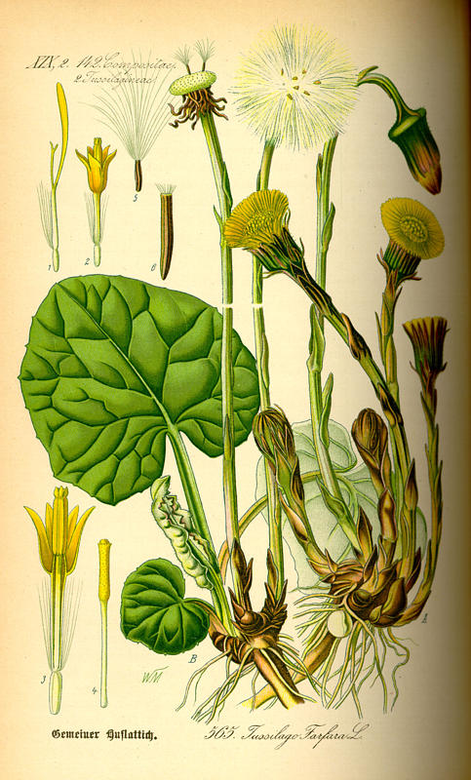
Trade-off
is defined as an evolutionary dilemma whereby genetic change conferring increased fitness in one circumstance inescapably involves sacrifice of fitness in another (Grime 2001).
Tussilago:
Light seeds: advantage for dispersal, but lack of energy for competition in crowded communities
Sempervivum:
water storage and minimizing surface is advantage in drought stress, but decreases photosynthesis under favourable conditions

Slide 20
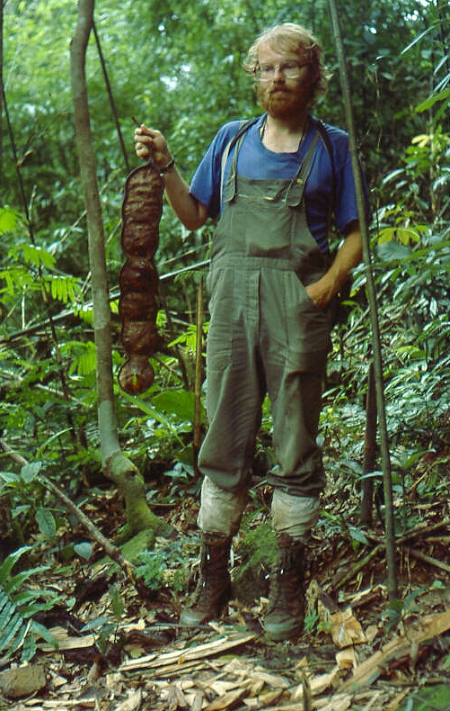
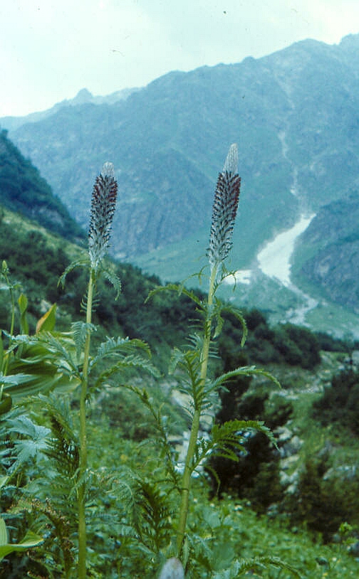
Pedicularis - dense hare in the inflorescence protects from frost, but is unnecessary investment in warmer conditions
Entada - Large seed size helps to overcome low light intensity in forest understory, but hinders dispersal

Slide 21
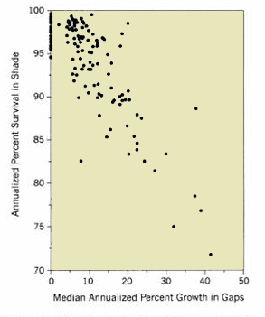
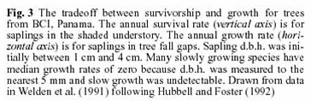
Trade-off
Negative correlation (trade-off) between seedling survival in shade and growth in gaps. There is no super-plant able to grow fast in gaps, which would be also able to survive in shade. There is a clear physiological constraint between ability to survive in shade (i.e. ability to photosynthetize in shade) and the growt rate in high light.
Each point is a species from tropical rain forest in Panama

Slide 22
For a bird – amount of fat to survive winter
I am very fat – I will probably survive long period of starvation, but my maneuverability (and so the ability to escape in the presence of predator) is low
I am slim, just muscles, no fat – great for escape, but not very resistent to cold and starvation
Which of those two states is advantegenous depends on weather in individual winter and onthe intensity of predation

Slide 23
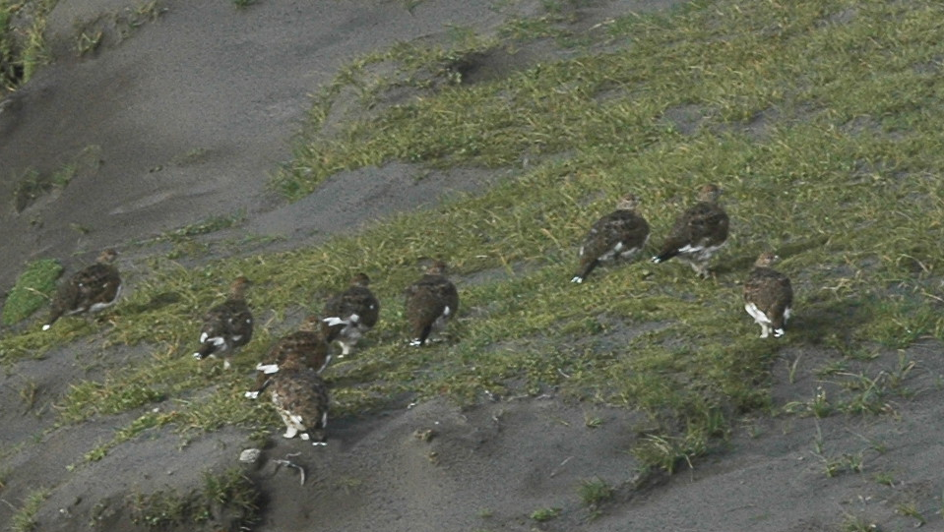
Ptarmigans in Iceland – nicely rounded, with lot of fat – well protected against cold, ability to escape is negligible

Slide 24
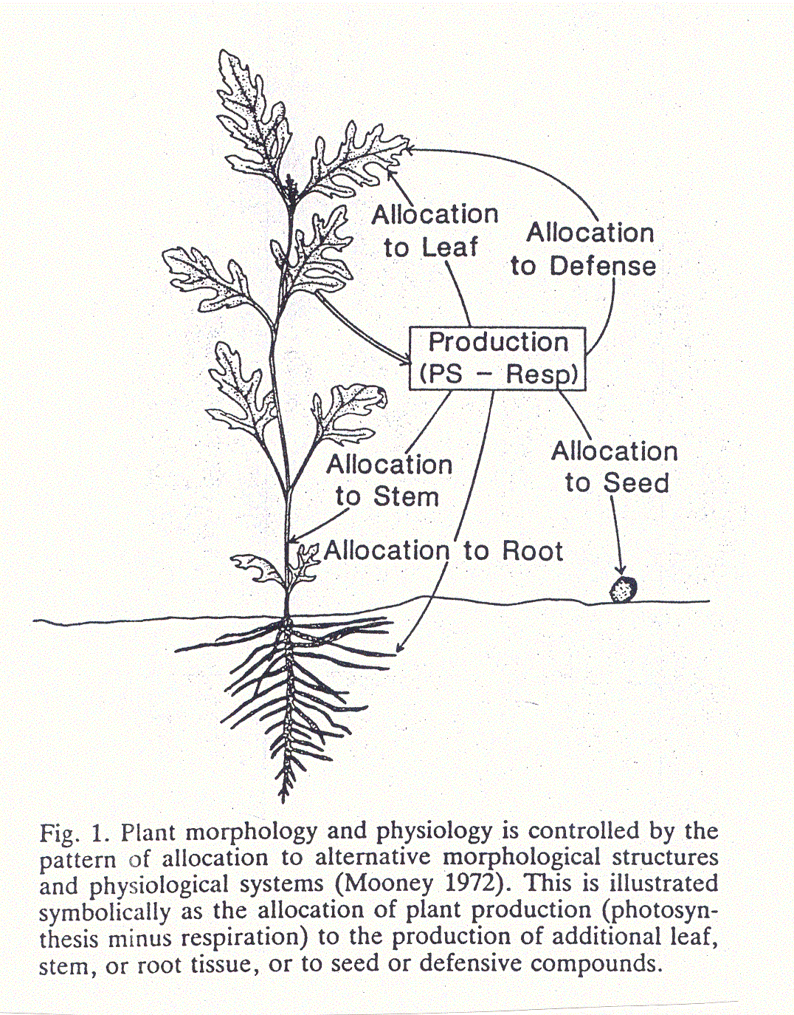

Slide 25
Which trade-off is important?
Selection by mortality
density independent vs. density dependent
Frequency of disturbance and successional age are analogous factors (just differing in point of view)
catastrophic events
r-selection
competition
K-selection
Disturbance
High
Low

Slide 26
Note: r- K- selection (and r- K-strategy are NOT merely descriptive categories, but Darwinian concepts predicting relationship between species traits (in modern terminnology) and density dependent/ independent selection

Slide 27
r-organisms | K-organisms
short-lived | long-lived
small | large
weak | strong or well-protected
waste a lot of energy | energy efficient
less intelligent, experienced... | more intelligent, experienced...
have large litters | have small litters
reproduce at an early age | reproduce at a late age
fast maturation | slow maturation
little care for offspring | much care for offspring
strong sex drive | weak sex drive
small size at birth | large size at birth
http://pespmc1.vub.ac.be/RKSELECT.html

Slide 28
Trade-offs (Examples)

Slide 29
Predictable environment,
low variation
unpredictable environment,
high variation

Slide 30
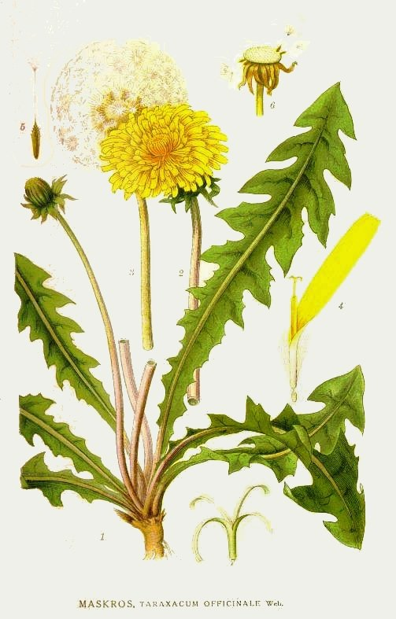
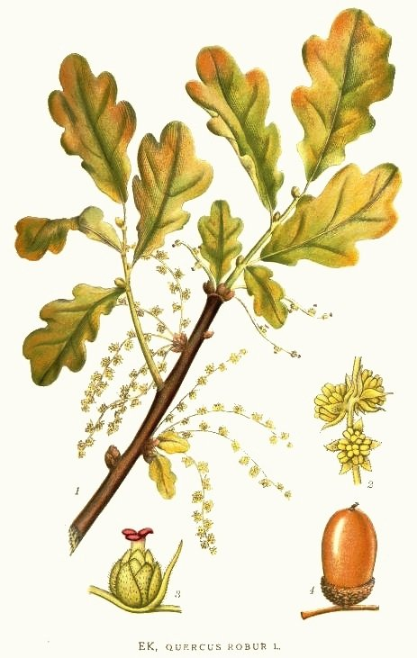
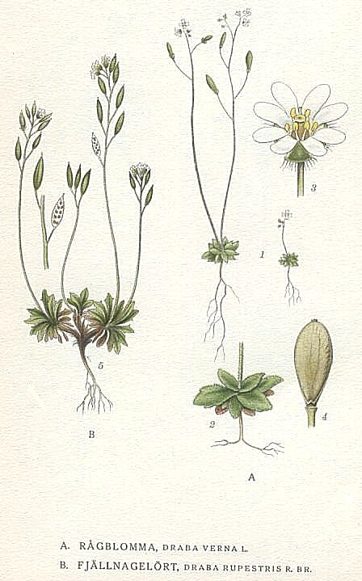
r-K continuum - strategies are relative
McArthur & Wilson (1967), Pianka (1971)
but MacLeod (1894) Capitalists and proletarians (in Dutch)

Slide 31
Is one axis sufficient?
And if not, which should be the second one?
Grime: the productivity / stress

Slide 32
Definitions
Stress: phenomena which restrict photosynthetic production, such as shortage of light, water, nutrients, sub-optimal temperatures
Disturbance: Partial or total destruction of the plant biomass and arises from the activities of herbivores, pathogens, man (trampling, mowing, ploughing) and from phenomena such as wind-damage, frosting, droughting. soil erosion, fire.

Slide 33
Problems:
the same external factor is perceived by one plant as disturbance, by another as stress:
extreme drought is disturbance for competitors, but stress for stress tolerators.
Where is the limit, below which the lack of water is considered disturbance, and where is considered stress?

Slide 34
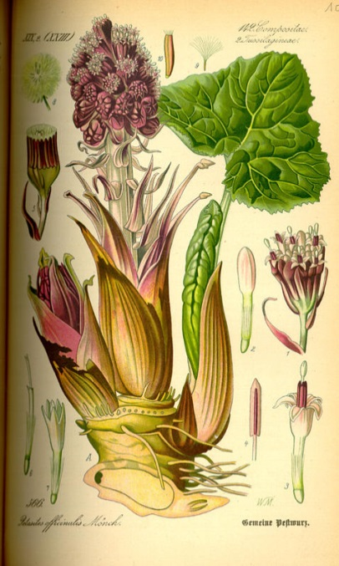
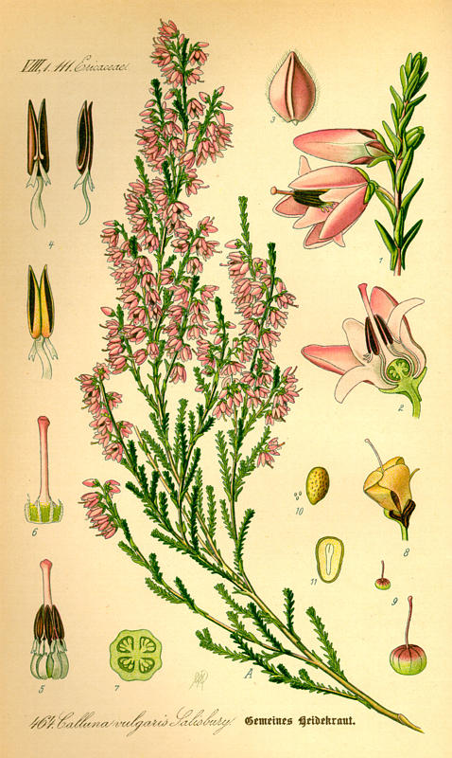
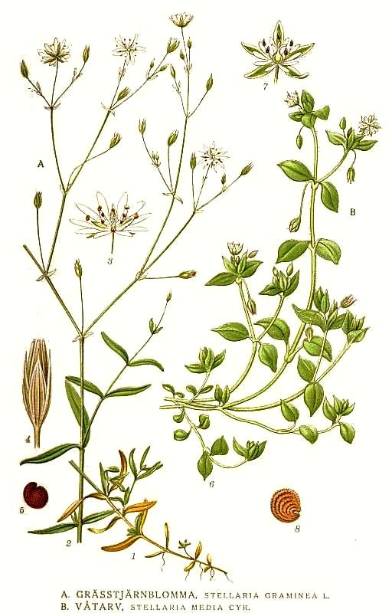
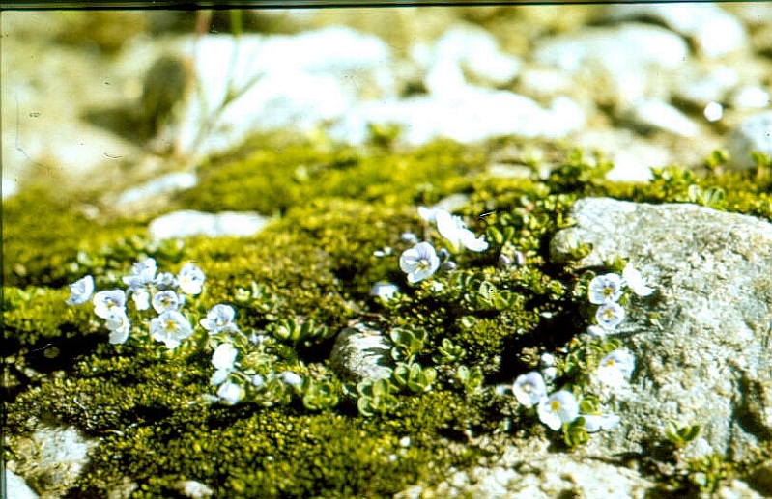
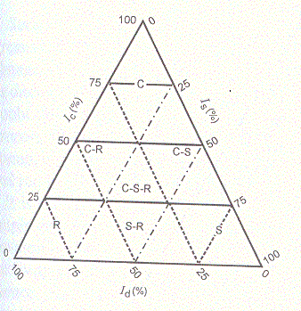

Slide 35
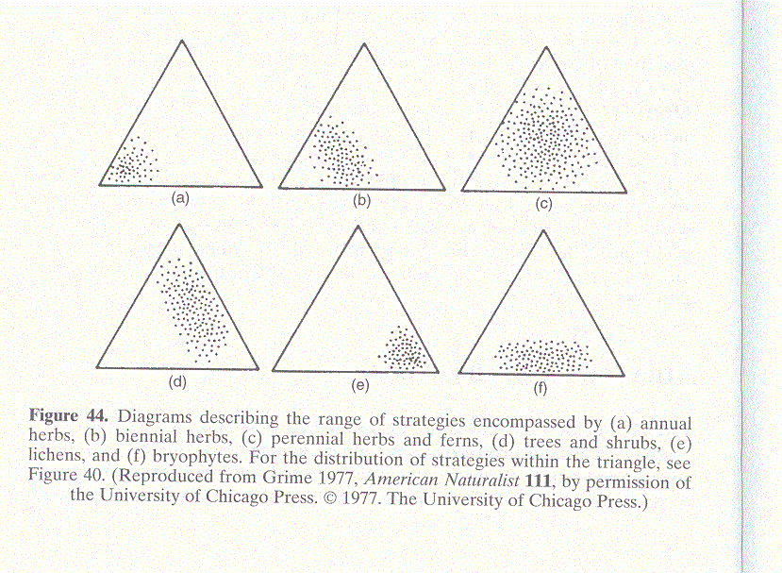
annuals
biennials
perennial herbs
trees and shrubs
lichens
bryophytes

Slide 36
Ramenskij (1938)
explorents = hyenadogs ~ Ruderals
violents = lions ~ Competitors
patients = camels ~ S-tolerators
Published in Russian

Slide 37
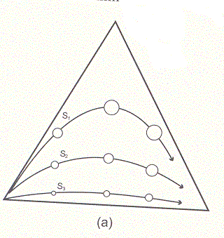
Succession
Relationship between r-K and CSR
productive habitat
unproductive habitat

Slide 38
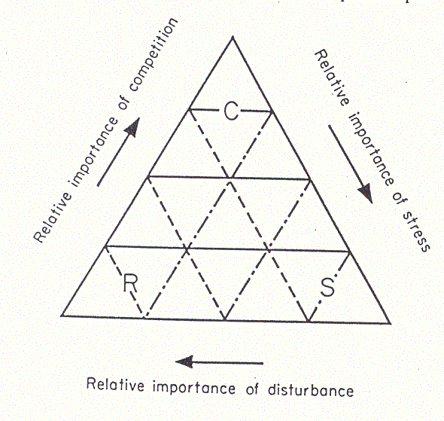
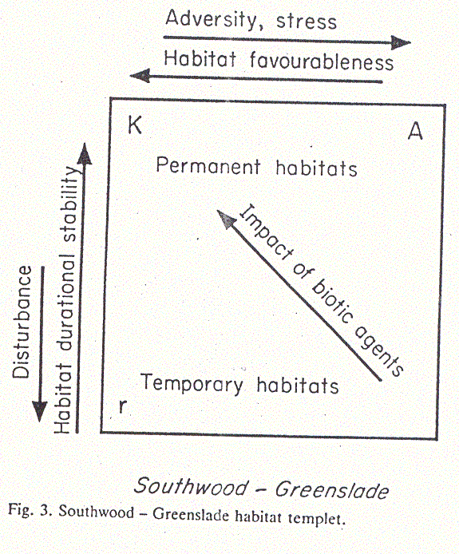
Comparison with habitat templet model

Slide 39
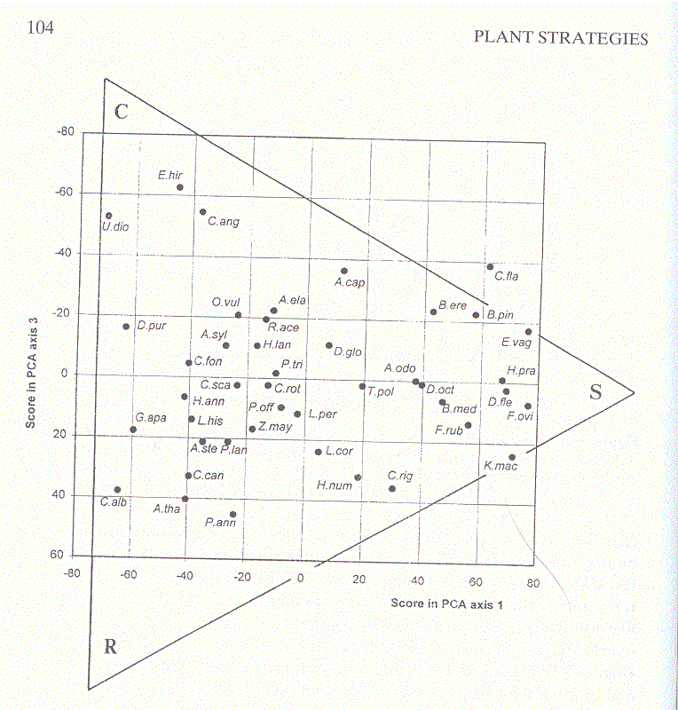
Tests using the multivariate analysis the traits od British plants: PCA of the data from Grime’s ISP (integrated screening program)
Epil. hirsutum
Festuca ovina, Desch. flexuosa
Arab. thal.
Poa annua

Slide 40
Strategies of regenerative phase:
V - Vegetative expansion
S - Seasonal regeneration in vegetation gaps
B_{s} - Regeneration involving a persistent bank of seeds
W - Regeneration involving numerous wind-dispersed seeds or spores
B_{sd} - Regeneration involving bank of persistent seedlings

Slide 41
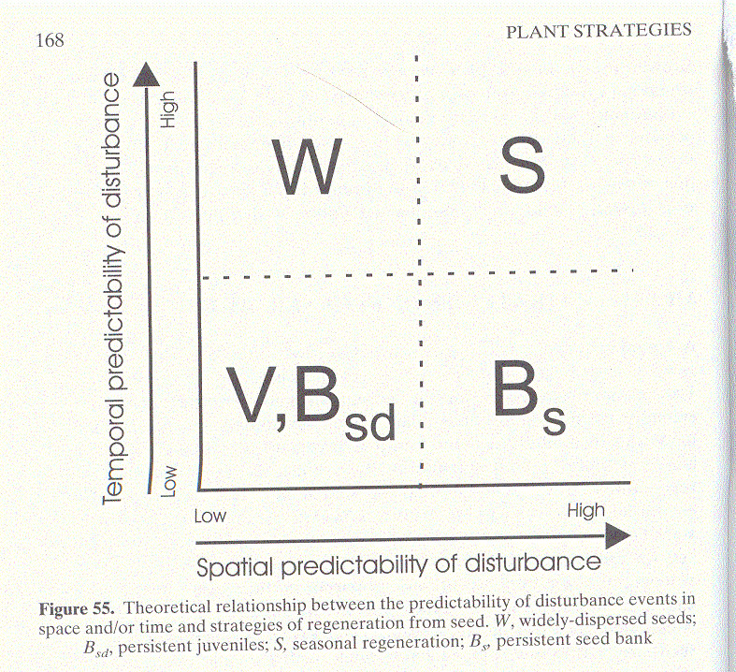
V - Vegetative expansion
S - Seasonal regeneration in vegetation gaps
Bs - Regeneration involving a persistent bank of seeds
W - Regeneration involving numerous wind-dispersed seeds or spores
Bsd - Regeneration involving bank of persistent seedlings

Slide 42
Recent trend: from broad categories (general strategies) to more detailed classifications (plant functional types)
Loss of generality vs. increased explanatory power
* Deductive systems vs. data based systems (three matrices problem)
Sites
Traits
Species
Env. var.

Slide 43
Species response to fertilization (RDA score, positive values mean that the species gains from fertilization)

Slide 44
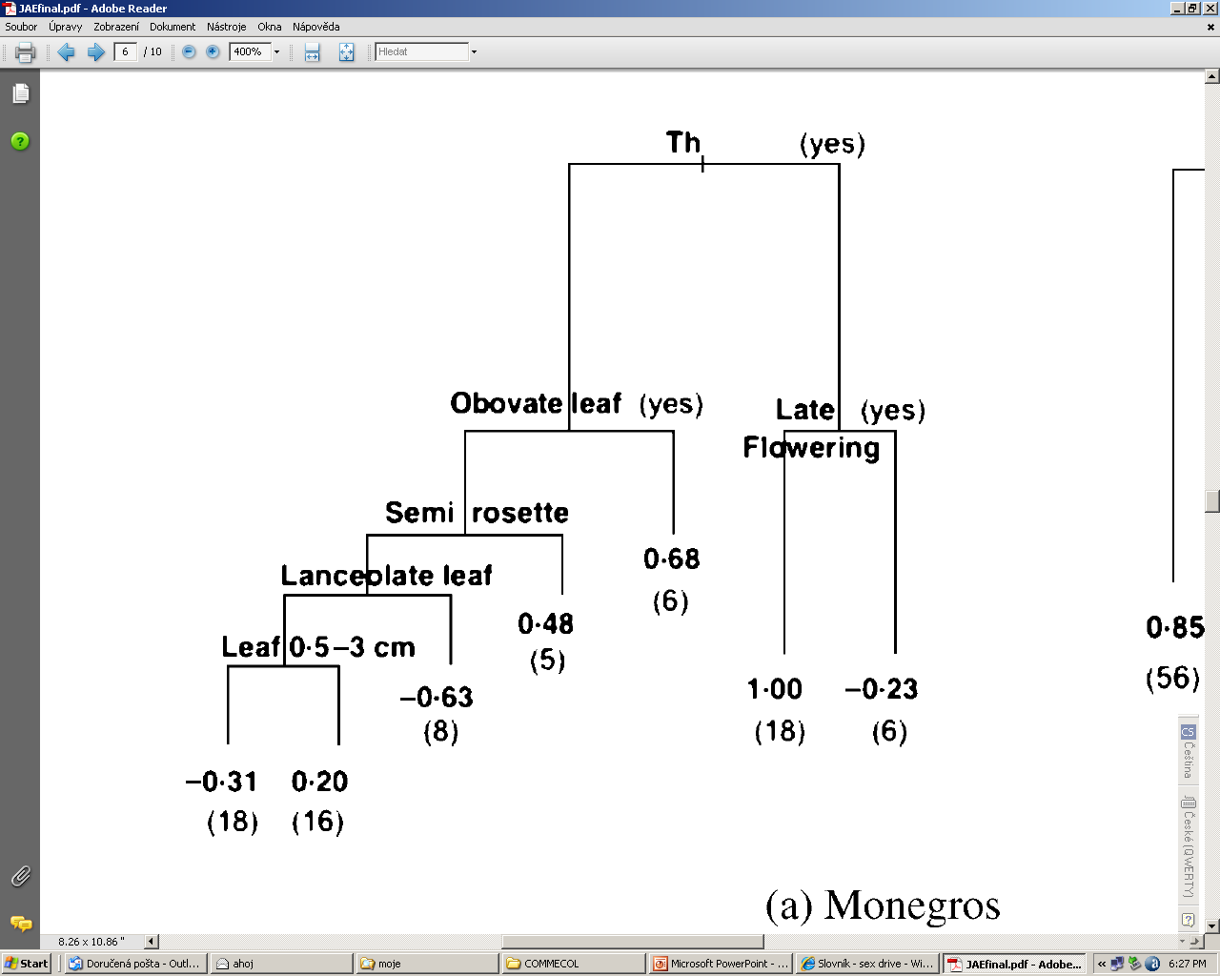
Species response to grazing predicted by traits

Slide 45
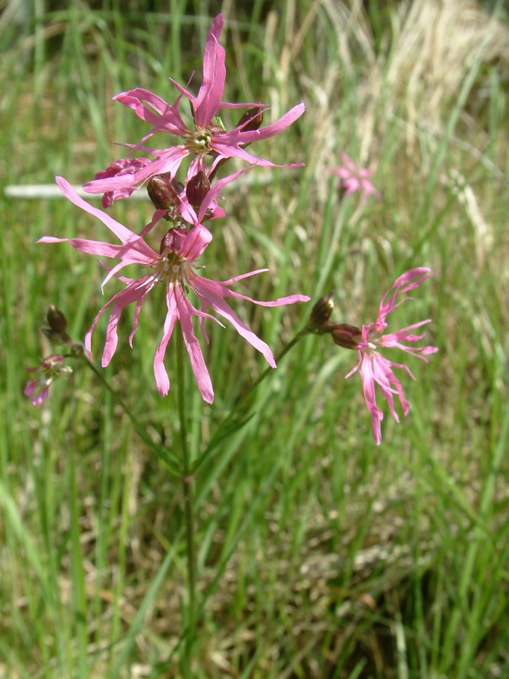
RDA - “species traits”
(treatment specific)

Slide 46
“Deductive” but data based
Select a priori some measurable characteristics: Westoby LHS
Plant height
Seed weight
SLA (Specific leaf area)
(And what about clonality?)

Slide 47
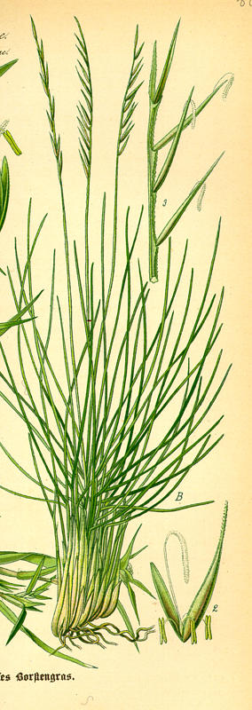
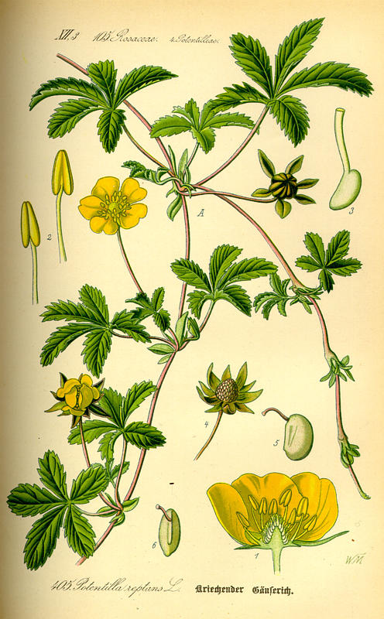
Guerrilla vs. Phalanx strategy in clonal plants
Nardus stricta
Potentilla reptans

Slide 48
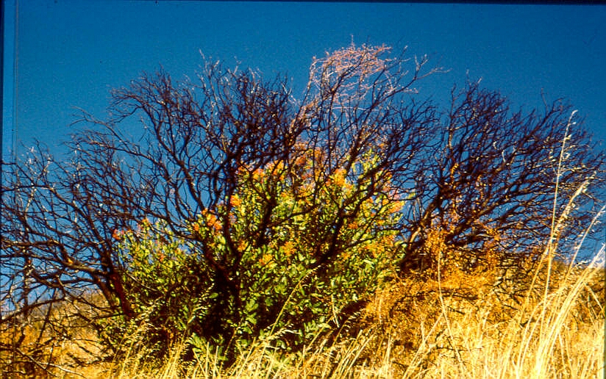
Pausas and Lavorel (2003)
Strategies in reaction to disturbances
Ability to survive on the level of
Individual (resprouting, underground organs)
Population (permanent seed bank)
Community (how to survive competition)
Landscape (metapopulation - ability to disperse)

Slide 49
Large projects: Building the data bases of species traits:
(traits measured in unified manner)
Integrated Screening Program / LEDA
From easily measurable morphological traits (soft traits) to more functional traits (needing much more work – hard traits)

Slide 50
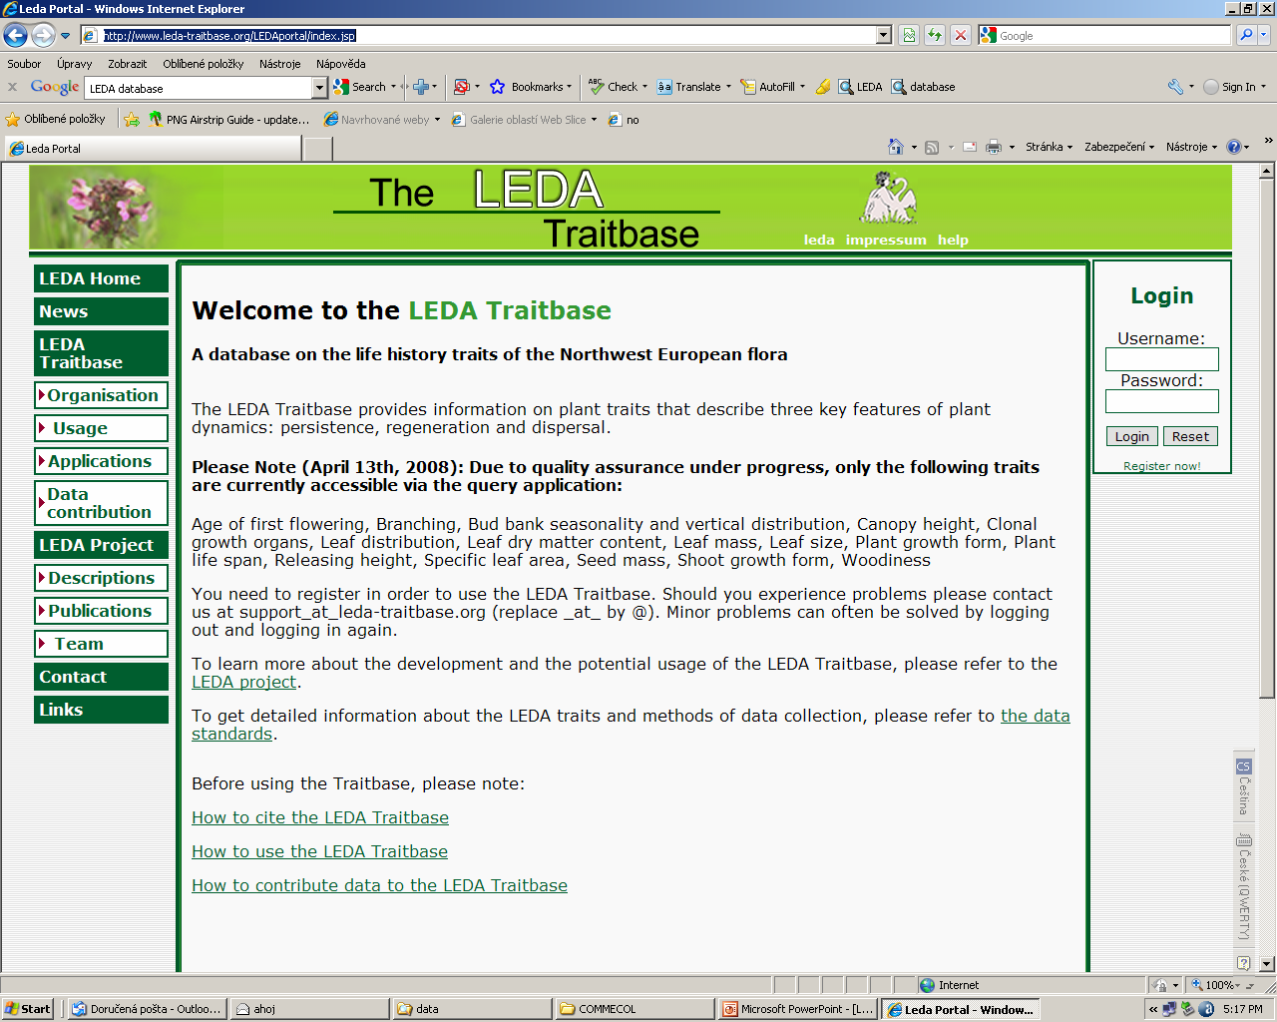
http://www.leda-traitbase.org/LEDAportal/index.jsp

Slide 51
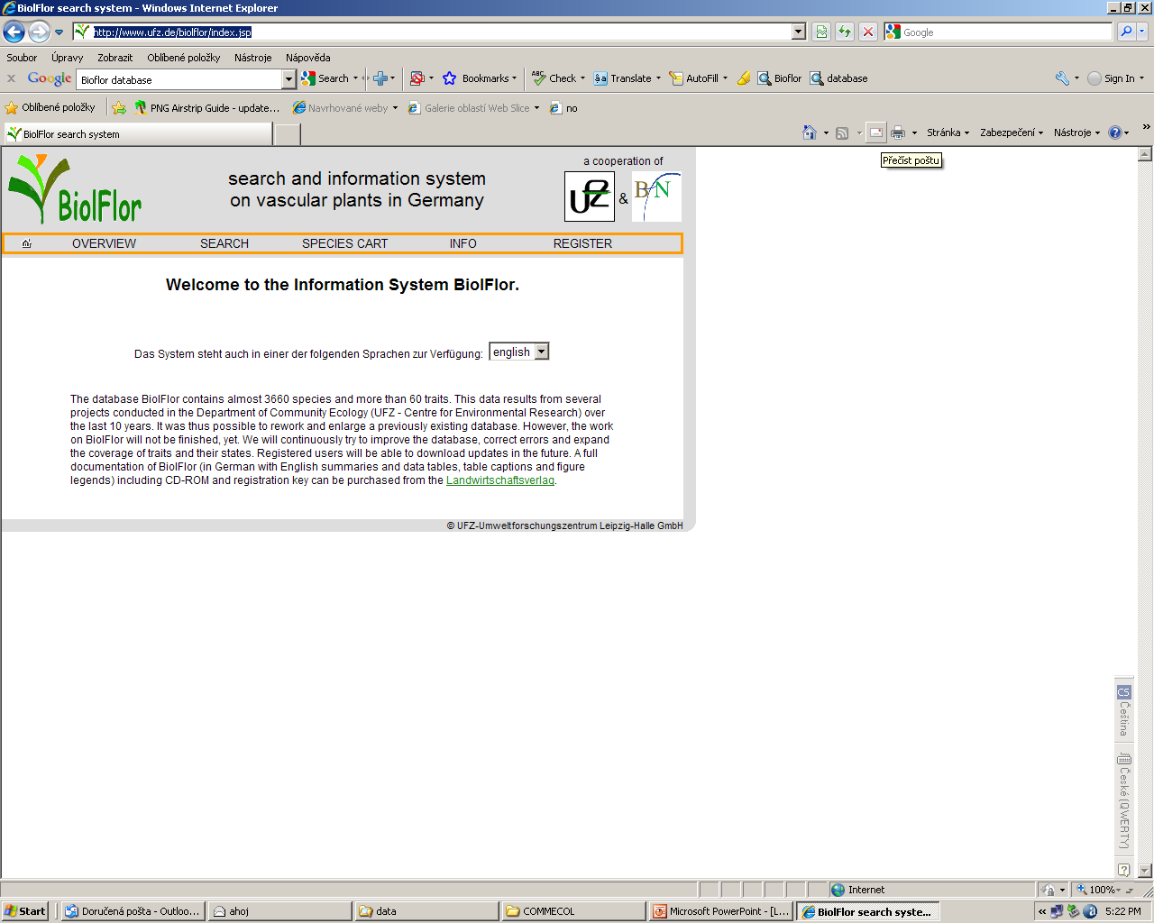
http://www.ufz.de/biolflor/index.jsp

Slide 52

http://data.kew.org/sid/

Slide 53

http://clopla.butbn.cas.cz/

Slide 54

Area of distribution as trait? http://www.fmnh.helsinki.fi/english/botany/afe/

Slide 55


Slide 56
Distinguish in analyses
1- Traits – measurable at a single individual (or perhaps population)
2- Strategies – synthetic characteristics, based on mixture of trait information and species habitat (ecological) preferences
3- Indicator values - synthetic characteristics, based on species habitat (ecological) preferences
It is not valid to explain spedies habitat preferences by 2 and 3

Slide 57
If you derive your strategy exclusively from the measured traits
e.g. the first and second PCA axis of the species x trait matrix
Or Pierce S. et al. (2017) A global method for calculating plant CSR ecological strategies applied across biomes world-wide. – Functional Ecology 31: 444–457
NO PROBLEM to use the results to explain species habitat preferences – there cannot be any circular reasoning

Slide 58
Area of distribution
Is not a trait, but is valuable information about a species, size of which need not be necessarily mathematically dependent on the habitat preferences
Valid hypotheses about relationship between habitat preferences and area of distribution, or about traits and area of distribution

Slide 59

Closed forest
Spitzer, K., Novotny, V., Tonner, M., & Leps, J. (1993). Habitat preferences, distribution and seasonality of the butterflies(Lepidoptera, Papilionoidea) in a montane tropical rain forest, Vietnam. Journal of Biogeography, 20(1), 109-121.
Disturbed places
Relationship between species geographical range (1 – endemic, 6- cosmopolitan) and habitat preferences on the forest disturbance gradient

Slide 60
Succession
Some theory first

Slide 61
What causes successional development?
PLANT SUCCESSION: LIFE HISTORY AND COMPETITION
MICHAEL HUSTON AND THOMAS SMITH
The American Naturalist 1987
1. Competition between individuals for resources occurs in all plant communities, although both the relevant resources and the intensity of competitive interactions may change through time and between communities.
2. Plants alter their environment in such a way that the relative availabilities of resources change, altering the criteria for competitive success.
3. Physiological and energetic constraints prevent any species from maximizing competitive ability for all circumstances. This produces an inverse correlation between certain groups of traits such that relative competitive abilities change over a range of environmental conditions.

Slide 62
Tilman’s tradeoffs important for succession
1. The colonization - nutrient competition
2. The colonization - light competition
3. The colonization - herbivory defense
4. The nutrient - light ratio (resource ratio)
5. The herbivory - nutrient competition
6. The herbivory - light competition
7. Maximal growth rate tradeoffs

Slide 63
For different successional series, different tradeoffs are important:
Example: Presence of seedbank:
Old-field succession: the seedbank of fast growing shade intolerant species (mostly arable weeds) present (and abundant) - nearly no anemochorous species in early stages
Succession on clear-cuts in forests: the seedbank absent - early stages composed of species with good dispersal abilities, often anemochorous
Both Colonization vs. Competition of Tilman

Slide 64
Primary vs. secondary succession
Facilitation vs. inhibition
In all cases, the earlier population have to be (competitively) displaced by the later one
Facilitation (difficulties to be proved experimentally) -
Not only improved soil condition, but also attracting propagule vectors etc. - but finally, the facilitator is displaced due to changed competitive equilibrium
Overlooked importance of soil pathogenes, herbivores, parasites etc. for the change of competitive equilibria

Slide 65

Succession on the gravel bars in Geog-Čaj River bed (East Caucasus)
Chronosequence
The oldest
Old
young

Slide 66

H.r. - Hypophae ramnoides – N fixation
F.o.- climax tree beech Fagus orientalis -
Diversity – maximum at intermediate stages
Biomasss increqases
Density of individuals - decreases

Slide 67




The youngest – anemochorous willows – small seeds – not able to establish in competitive environment
Hypophae rhamnoides – hosts N fixators

Slide 68
Willows - does not seem to facilitate the establishment of their successors – nevertheless, forming environment suitable for birds (hiding and nesting), they might substantially increase the probability of dispersal of endozoochorous species.
Hypophae rhamnoides - improvement of N condition not only for Fagus (facilitation), but also for its own individuals, Nevertheless, the improvement for Fagus is more important, the beech is taller and out competes Hypophae

Slide 69
Permanent plots vs. chronosequence
Permanent plots are ideal, but our lives are too short…
Importance of long-term ecological research, some permanent plots are very old, chance to re-locate the plots recorded long time ago..

Slide 70
Chronosequence
(space for time substitution)
In many cases the only chance to study long-term succession
Assumption – individual plots differ just in the time of succession initiation (difficult to prove); and
There is just one big disturbance initiating succession, the other disturbances are fairly less important
The dating of plots should be independent of “response variable”

Slide 71
Problems:
The confounding of topographic position and age
Repeated disturbances, which are natural part of most communities, and temporarily change the course of succession

Slide 72
Possibilities of “verification”
Repeated observations of plots within chronosequence
“Verification” of the direction of changes
Separation of short term and long-term dynamics

Slide 73
Succession – or vegetation dynamics?
Spatial and temporal scales
What is climax
Some authors prefer “vegetation dynamics”

Slide 74
Succession
F.E. Clemens (1916+) vs. Gleason
Clemens - superorganisms (organismic view of succession) - succession is analogical to development of an individual
H. Gleason - individualistic view of succession
(Newer version of the controversy) Are there any “emergent properties” of communities?

Slide 75
Spatial scale
Succession in a gap (plant’s eye view); gap in meadow 10⁻² m² vs. gap in the forest 10² m²
Succession on ant hill (in a meadow) 10⁻¹ m²
Succession in an abandoned field 10³ m²
Succession after wildfire 10⁶ m²
Succession on a newly emerged island (Surtsey)

Slide 76
Climax - terminology
Blocked successional stage
Subclimax, edaphic climax, fire climax. cyclic climax
Monoclimax vs. polyclimax theory

Slide 77
Climax
“Final stage”
Dynamic equilibrium of various successional stages - mosaic of patches of different successional stages (spatial scale problem)
Temporal (long term climate changes) - temporal scale problem

Slide 78

Various age categories present, mosaic of successional stages of gaps, dead logs as a substrate for wood decaying fungi – old grown forest – Žofín – photo Jhonny Capichoni

Slide 79

Dynamic equilibrium - Markovian (transition matrix) succession models

Slide 80
Climax defined by dominant eigenvector

Slide 81


Slide 82


Slide 83
Gap dynamics
Popular in forest ecology, but applicable to herbaceous communities also
Regeneration niche theory as appreciation of the role of repeated succession for maintenance of species diversity

Slide 84
Individual based models
Each individual is described by a variable (or set of variables)
In each time step, the growth of an individual is function of size of the individual, and of competition pressure
In each time step, the probability of survival is determined as a function of the size of the individual, and competition pressure
The survival is decided by a random process

Slide 85
Convergence - divergence
Importance of the environmental window taken into account
Role of “random” factors in successional development

Slide 86

Environmental window

Slide 87
Is succession predictable?
The course of succession is influenced both by the measurable characteristics of environment and “chance factors” (“random events”).
Which random events can alter the successional pathway?

Slide 88
Predictability of succession
Random events affecting successional pathway
How to define a random event (do nor confuse with random factor in ANOVA) ?
Example - Chelčice old field succession
Colonization by willows
“Successional window” for establishment - if missed, the community is dominated by competitively strong grasses

Slide 89
What is “random event”? as opposed to a measurable habitat characteristic
Operational definition “Events of irregular occurrence, events which are difficult to measure / trace back.”
Even so, the decision what is random event is often arbitrary.

Slide 90
Difficulties:
Real random events are difficult to plan.
They do not appear in proper experimental design.
Their importance is recognized “ex post”.

Slide 91
Case study in an old field in South Bohemia (Chelčice)
F1: Abandoned in late seventies
Details unknown
No shrubs
10 m
F2: Abandoned in 1986
Last crop Zea mays, ploughed after harvest
Succession with willows
F3: Abandoned in 1991
Last crop clower and ryegrass
Herbaceous succession

Slide 92

Only F2 intensively studied:

Slide 93


Field in 1994 (F2: 9years)

Slide 94

F3: 4 years
border between F2 and F3

Slide 95

Fields in 2003: F2 (18 years), F3 (13 years)

Slide 97


Slide 98

Very sharp border
The only difference is in the year of abandonment, and last year crop
Note - willow seeds - extremely good in dispersal; viable for two weeks only

Slide 99
Permanent plots in the F2 field (i.e the plots with shrub succession)
5 permanent plots 1m x 1m, divided into 100 subplots, 10cm x 10 cm each
Data available:
species composition of all the subplots during the years 1986-1994;
history of establishment, survival and heights of shrubs

Slide 100
When the shrubs get established, and how they survived through years?
All the species: Salix capraea, S. cinerea, Populus tremula

Slide 101

Priority effects
Species arriving ealy have an advantage in competition
Can their effect persist for longer time?

Slide 102
Sowing (of the BEF experiment type)
And the plots were not weeded and open to natural colonization
Although the plots were of the size 10m x 10m, and all were mown with the same machinery, the effect of sowing was detectable even after 20 yrs (less for some species, 20 yrs for Lathyrus pratensis)

Slide 103
Ecological stability

Slide 104

What is ecological stability?
* being in “equilibrium”?
* constancy
* resilience
* resistance
*persistence

Slide 105
What is stability determined with
Variability of individual species – determined by the environment and its variability
Properties of the community, particularly by the community diversity

Slide 106



Slide 107

Comparison of stability of young and old fallow (as a response to an extreme drought):
the response is determined by the prevailing life history

Slide 108

The decisive are species life history strategies (determined by environment)

Slide 109
Stabilizing effect of diversity - decrease of one species can be compensated by icrease of another
(A)synchrony of temporal fluctuations

Slide 110

Communities with fast and pronounced response to weather fluctuation will have higher temporal variability
Temporal variability: measured by coefficient of variation
CV = s.d./mean

Slide 111



Slide 112
The coefficient of variation of biomass of community composed of k species is then (when species fluctuate independently)

Slide 113
The effect is strengthened by negative (temporal) correlation between species, and weakened by positive correlation between species. However, CV_{community} never exceeds CV_{species}, and reaches the same value only when the species variation is perfectly positively correlated.
Deviation from perfect correlation is called asynchrony, and stabilizes the community biomass fluctuation

Slide 114

Other measures of asynchrony were also suggested (here Gross et al. 2014)

Slide 115
Suggested merasure φ
Loreau and Mazancourt 2008
Doe not provide any possibility to compare with the null model of independence
In the case of of indepednence, its value decreases with number of species

Slide 116
(A)Synchrony caused by
Synchronization – concordant response to temporal changes in environment (probably mostly weather in individual years)
Asynchrony – discordant response to temporal changes in environment and / or competition

Slide 117
Term „asynchrony“ is used inconsistently
Some use it as any deviation from synchrony (so, everything is then asynchronous, because perfect synchrony does not exist)
Some just for the situation when the correlations are on average negative (or better, sums of covariances are negative) – perhaps, for this it is better to use compensatory dynamics or antisynchrony

Slide 118
Compensatory dynamics caused by
– discordant response to temporal changes in environment (rather unlikely, all plants love similar weather – in grassland warm and wet spring)
Competition – if the dominant is harmed by dry spring, less competitive plants can profit
Neglected role of enemis (pathogens) – in dry habitats: some species can take advantage of wet spring, some can be harmed by fungal pothegens

Slide 119
Effect of Asynchrony/Compensatory dynamics on stability (total bomass CV) depends on
Total number of species
Equitability - (species that form 0,01% of the community has negligible effect on the total biomass)
Whether the abundant and rare species fluctute in the same extend

Slide 120
Taylor’s power law (TPL)
var = a . mean^{b}
log(var) = log a + b .log(mean)
Both, var and mean are random variables, and after log transformation will have roughly the same “error” –> classical OLS underestimated the value of b

Slide 121
We use TPL for temporal variation, but the same basic rules apply for temporal and spatial variation
TPL was used to describe relationship of var and mean of the same species in various sites
TPL can be equally well used to describe mean and var of a set of species within a single community
[both can describe spatial and temporal variation]
Can be used for counts of individuals, but also for any other quantity – does not work for individuals, when the density is low ~ <1, would not work for 0 / 1 , i.e. presence absence data
Generally, there is no theory behind, log – log linearizes quite a lot of various relationships

Slide 122
The classics
If data have Poisson distribution (valid just for the counts), then var = mean
P.d. assumes independence of individuals
Var/mean ratio as the spatial aggregation measure, and after multiplying by df as a test criterion (chi-square distribution), the same theoretically can be used for temporal variation (practically not used)

Slide 123
Poisson distribution
If two variables with Poisson are summed up, their distribution is again Poisson mean = mean1 + mean2, var = var1+var2
In this case, TPL holds, and b=1
Generally, never happens (would be the case, if the population is constant, large, and each individual has some constant probability to fall in the trap, and x is the number of trapped individuals)

Slide 124
Poisson distribution is extremely rare
In fact, in most cases, we have (both temporal and spatial) variability in data corresponding to contagious distributions (clumps of clumps)
Negative binomial, or Neyman distributions
In these cases, b > 1

Slide 125
If b=2
CV (s.d./mean) is independent of mean
var (log(x)) is independent of mean
– but var (log(x+1)) decreases with mean
If 1 < b < 2 (generally, vast majority of cases)
both CV and var (log(x)) decrease with the mean

Slide 126
The fact that b<2
Makes the portfolio effect uncertain (the very abundant species will have low CV).
If I have variability of individual units within a species, then b<2 means that the individual units are not perfectly synchronized. (Thanks to this, there is some asynchrony within population.) Portfolio effect works, if the units within a species are better synchronized (less asynchronous), than units among species.

